Slide 1
Department of Mathematics and Natural Sciences
CHE 101: Introduction to Chemistry
Lecturer: Afsana Tasnim Oshin
Section A, Lecture 2
Content: Rutherford’s atomic theory, Bohr’s atomic theory, spectrum

Slide 2
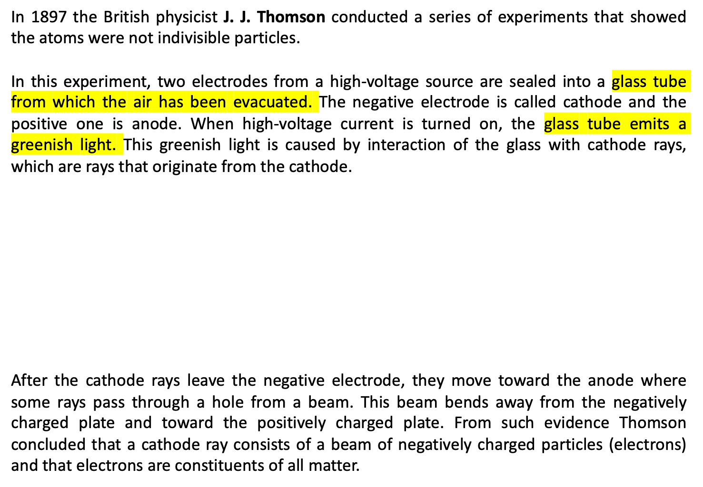
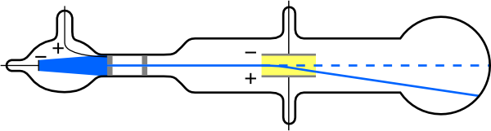
Discovery of the Electron
Electrically charged plates
Cathode (-)
Anode (+)
Fig: Formation of cathode rays

Slide 3
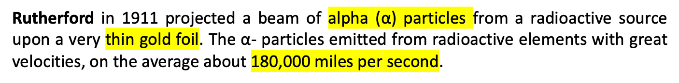
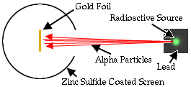
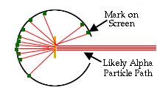
Idea of nucleus:
The gold foil experiment or α- scattering experiment
Observed results
most alpha particles were observed to pass straight through the gold foil without deflection
2. a few were scattered at large angles
3. some even bounced back toward the source as if the α-particles have met with some obstacles in their onward journey

Slide 4
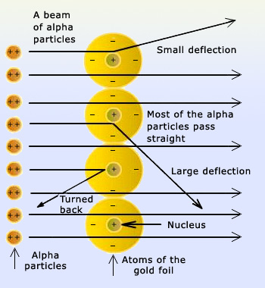
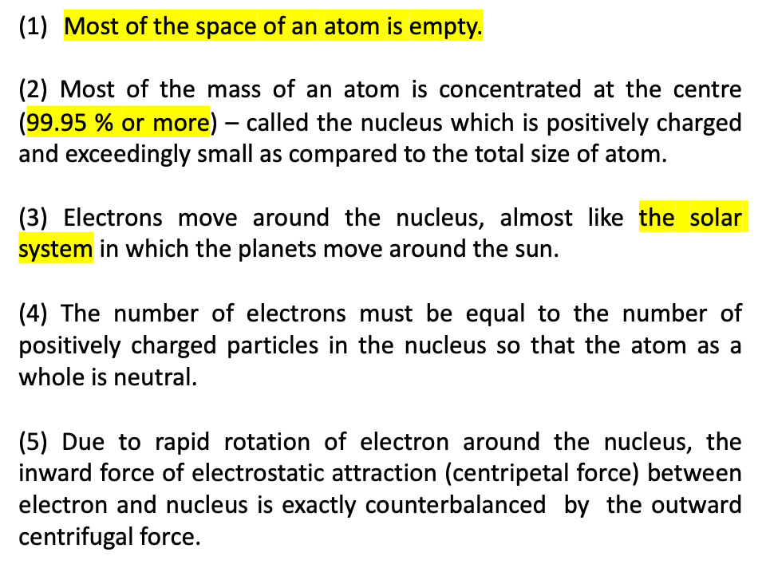
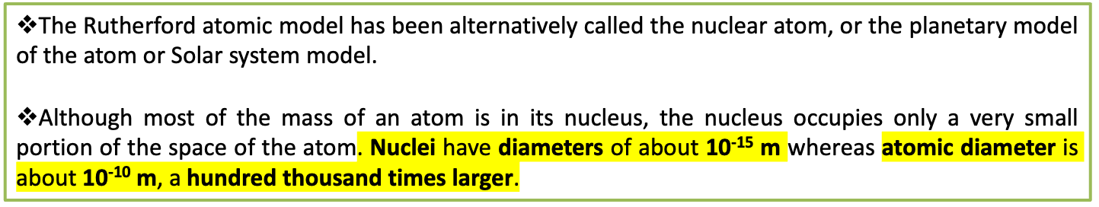
Inferences/ Rutherford’s Atom Model
Fig: Deflection of α- particles by nuclei in a metal foil

Slide 5
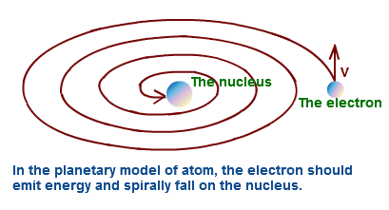
Limitations of Rutherford Atom Model
This model is based upon Newton’s laws of motion and gravitation. But Newton’s laws of motion and gravitation can only be applied to neutral bodies such as planets and not to charged bodies such as tiny electrons moving round a positive nucleus. The analogy does not hold good since the electrons in an atom repel one another, whereas planets attract each other because of gravitational forces. Besides there is electrostatic attraction in a nuclear atom model.
According to Maxwell’s electromagnetic theory, any charged body such as electrons rotating in an orbit must radiate energy continuously thereby losing kinetic energy. Thus rotating electron will lose energy and its orbit will become smaller and smaller and it will ultimately fall into the nucleus following a spiral path, annihilating the atom model.
If there is continuous emission of radiation, the spectra of an atom will be a band or continuous spectra. But an atom gives discontinuous or line spectra.
Rutherford did not give any idea about the shape of the orbits.
There was no explanation about the rotation of electrons in an atom with many electrons.

Slide 6
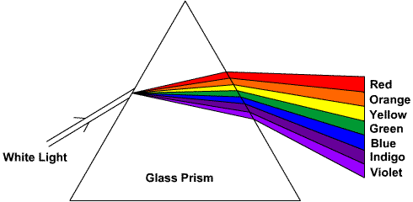

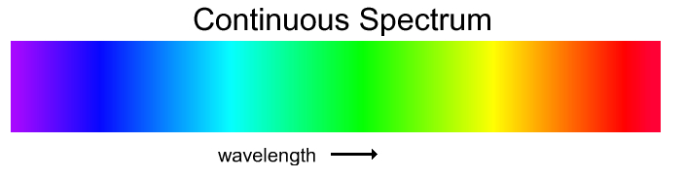
Spectrum and hydrogen spectrum
When white light is passed through a prism it is resolved into various color components of different wave length, and what is obtained is called a spectrum.
In the seventeenth century Newton showed that sun light is composed of various color components (which can be combined to produce white light as well).
Line Spectrum: A spectrum showing only certain colors or specific wavelengths of light.
Continuous spectrum: A spectrum containing light of all wavelengths.
Example: rainbow

Slide 7
Q: Is the spectrum for the incandescent light a continuous spectrum or a line spectrum?
Ans: Incandescent bulb is equivalent to white light, i.e it has all the seven wavelengths of light. Therefore when passed through a prism it is disperses into all the seven wavelengths without any spaces or boundaries and is obtained on the screen as a continuous spectrum.
Emission spectrum: If atoms or molecules are heated to sufficiently high temperature, they emit light of certain wavelengths. The pattern of frequencies emitted by the substance is called emission spectrum. From the emission spectrum we get bright lines.
Q: How is a bright line spectrum produced?
When electrons jump from the excited state to the ground state, the electrons emit energy in the form of light, producing a bright-line spectrum. Each element has its own unique bright-line spectrum.
Absorption spectrum: When white light is passed through a substance, black lines appear in the spectrum where light of some wavelengths have been absorbed by the substance. The pattern of frequencies absorbed by the substance is called absorption spectrum.
From the absorption spectrum we get dark lines.

Slide 8
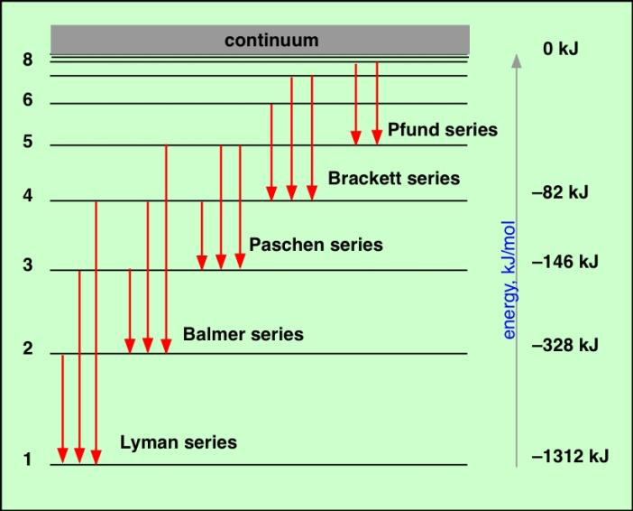
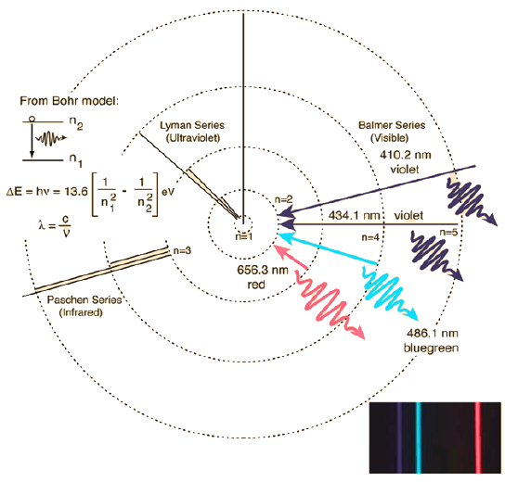
H-atom spectrum

Slide 9
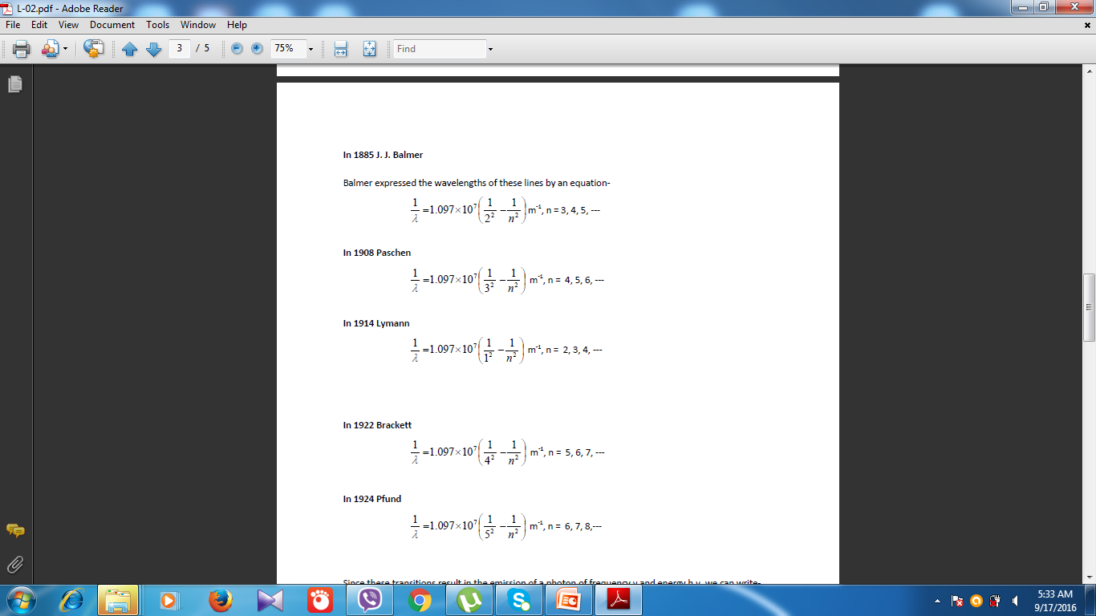

Slide 10
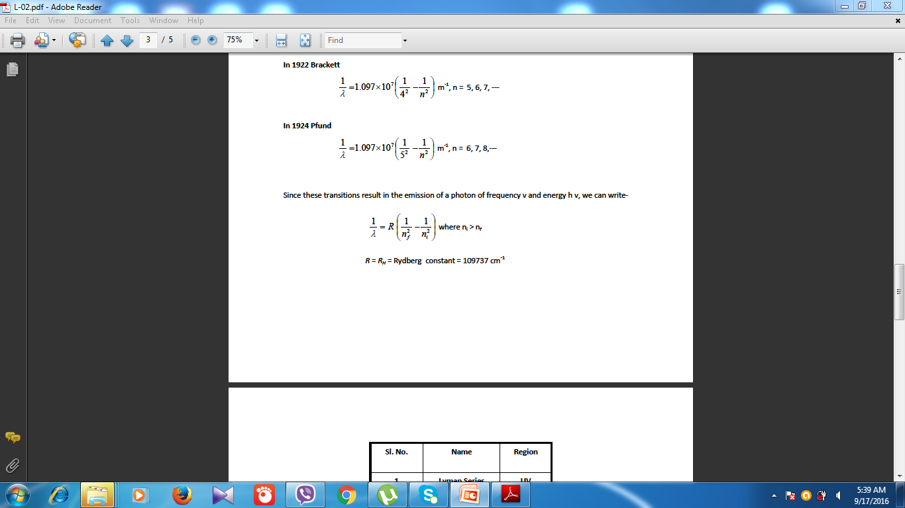
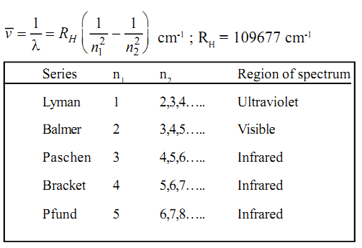
Rydberg equation:

Slide 11
Bohr’s Atom Model
Postulates of Energy Levels
An atom has a number of stable orbits in which an electron can revolve without the radiation of energy. These orbits are referred to as ‘Energy Levels’.
An electron moving in an orbit can have only certain amount of energy, not an infinite number of values, i.e., its energy is quantized.
While rotating in an orbit an electron does not absorb or emit energy.
The energy that an electron needs in order to move in a particular orbit depends on the radius of the orbit. An electron in an orbit distant from the nucleus requires higher energy than an electron in an orbit near the nucleus.
If the electrons moves in a circular orbit, its motion is subject to the ordinary laws of electrical and centrifugal force. These orbits are decided by the condition that the angular momentum of the electron in such orbit must be an integral multiple of h/2π, that is,
mvr = nh/2π
where, m is the mass of the electron, v is its velocity, r is the radius of the orbit, h is the Plank’s constant and n is 1, 2, 3, 4, 5 etc.

Slide 12
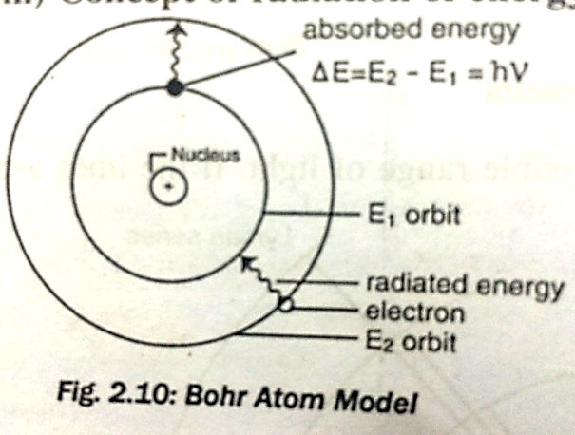
Postulates of radiation of energy
When an electron jumps from one energy level to another there is absorption or emission of energy. When an electron moves from a higher energy level to lower energy level there is emission of radiation and when electron moves from a lower level to a higher one there is absorption of radiation. The energy radiated is electromagnetic.
If E₁ and E₂ are energies of electron in the initial and final levels respectively, the difference of energy radiated when the electron passes from the higher to the lower energy level is given by the relation: E₂ – E₁ = hʋ
where h is the Plank’s constant and ʋ is the frequency of radiation.

Slide 13
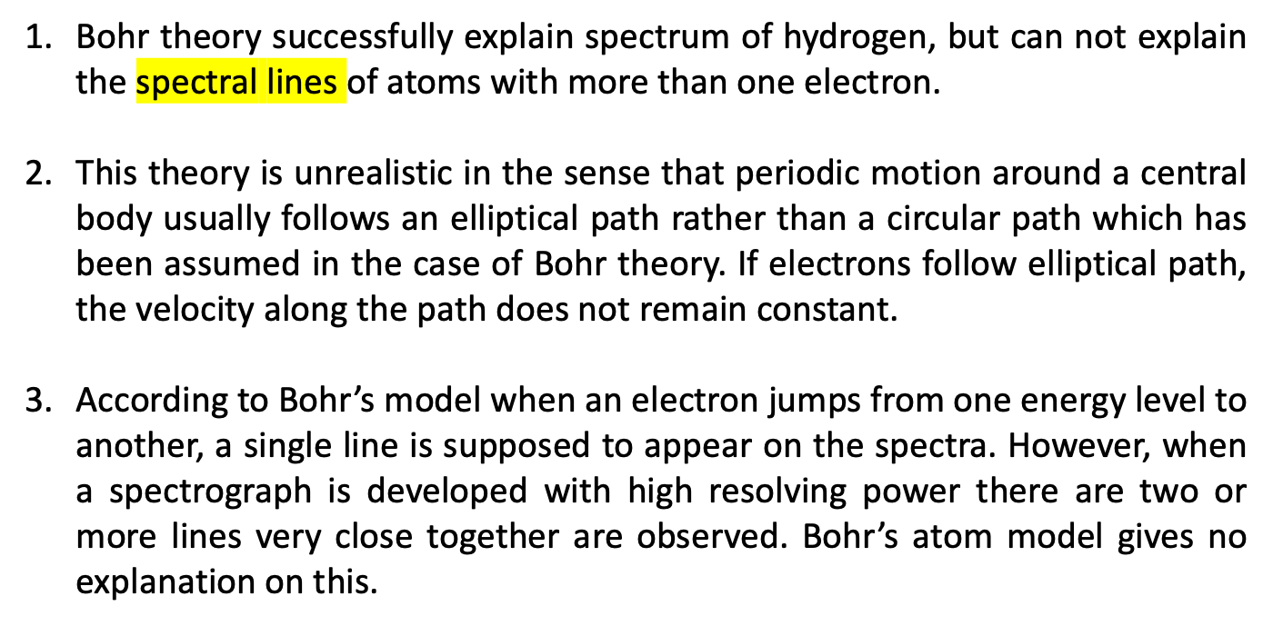
Limitations of Bohr Theory

